Slide 1
ZIV Delta – Zalaszentivan deltatrack construction
Kick-Off Meeting – 11.09.2026.
Hitachi Rail – Internal
Notes:
Luca to introduce himself…
***
Today we are here to tell, and more importantly, show you, how Hitachi Rail is pioneering a green transformation of Rail.

Slide 2
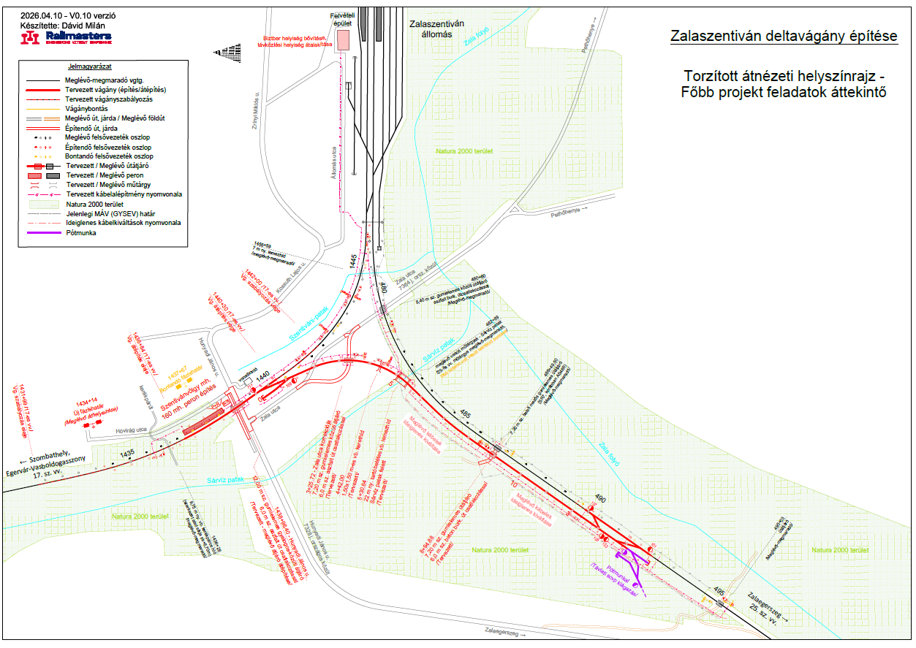
Overview

Slide 3
Project Structure and Stakeholders
GYSEV
Swietelsky Vasúttechnika
(Cons. leader)
V-S Zala Consortium
V-Híd Network
(Cons. member)
Hitachi Rail Hungary
Hitachi Rail
Austria
FŐBER
GYSEV
KÉMI (KTI)
Customer
Main Contractor (Scope: Trackside, OCL, Civil Works, Utilities, Cable Ducting Works, IXL, ETCS, Telco)
(Effective date of contract: 09.04.2026.)
Lvl 1. Subcontractor (Scope: IXL, ETCS , Telco)
(Effective date of contract: 15.06.2026.)
Lvl 2. Subcontractor (Scope: IXL, ETCS)
(Contract is not yet signed. Under preparation.)
Indep. Enginner
NoBo, DeBo, AsBo
End User

Slide 4
OBS ZIV Delta – Project Team Organisation
Updated to Project Management 2.0 / PTO role principles
Core project team
PROJECT MANAGER
G. PAPP
Support / governance
PROJECT CONTROLLER
W. WIMMER
PROJECT QUALITY MANAGER
D. DAYLAN
PROJECT DESIGN AUTHORITY
S. NEMETH
PROJECT PLANNER
G. PAPP
CONTRACT MANAGER
R. HEGEDUS
SUPPLY CHAIN AND PROCUREMENT MANAGER
T. HITZINGER
PROJECT ENGINEER
R. SZALAY
REQUIREMENTS MANAGER
S. CHUM.
SECURITY MANAGER
T. FISCHER
HSE REFERENT
L. PASZTOR
PROJECT RAMS MANAGER
F. MOSER
DOCUMENTATION MANAGER
J. UJHELYI
PMO
M. ALARSAN
Level 2 roles / work packages under PM or PE
PMO SUPPORT
A. BIKSZADY
SAFETY MANAGER
G. PATAKI
SYSTEM / ENGINEERING
IV / VERIFICATION
VALIDATION / VQ
DEPLOYMENT WPM
SERVICE / WARRANTY
System Architect
J. BIRO
IV Manager
B. HOFSTETTER
VQ Manager
M. GRONAU
Work Package Manager – Local Deployment
D. TOTH
Service Engineering Warranty
M. SZABO
CAE Engineering ETCS L2
G. HAMMER
ETCS Dyn. Tester
L. HALASZ
Validation IXL
M. GRONAU
Installation / Site Manager
T. SZENDI / IXL & ETCS
ETCS Tester / Integrator
CS. KOTOGANY
CAE Engineering IXL
D. PICK
Validation ETCS
M. GRONAU
Customer Training
I. TOROK / ETCS · L. KUKK / IXL
IXL Tester
B. MATE & CS. KOTOGANY
Config. Manager
R. SZALAY
IXL Verification
K. SZONYI
Data P. Verification ETCS L2
L. HALASZ

Slide 5
Subsystems
Interlocking Upgrading the current ZIV ELEKTRA 1 station IXL to ELEKTRA 2 extended with the new deltra track topology. Upgrading of AKF and Super AKF systems ETCS Adjusting ETCS L2 Entry and Exit points to the new topology (the L2 supervised area will be extended towards the open line). DAKO SW update (DAKO_PV_01.02.02) planned. RBC generic SW remains the same (RBC HU 1.2.1.A). RBC (HW Release 3.1) remains; no HW upgrade planned. HIS SW (BL HIS_RBC_GSV_2.15.0.11) will be upgraded. ETCS UNISIG Baseline: remains SRS 2.3.0d version.

Slide 6
Applied Products
ELEKTRA 2 interlocking (LockTrac 6131, PV INT 2.9.1A) – New delivery for ZIV station topology. RBC (Radio Block Centre) (AlTrac 6481, RBC HU 1.2.1A) – Existing HW. SW update with the new delta topology. AzLM Axle counter: (FieldTrac 6315) New HW+SW delivered for the new delta topology. A3 Axle counter: Existing HW+SW, remains for the current topology. AKF: Existing HW. SW updated for the new delta topology. EuroBalises (Siemens S21 ERL6, UBH-3 balise holders), existing HW+SW. Extended/updated with the new delta topology.

Slide 7
Technical Summary
Installation of new ELEKTRA 2 interlocking at ZIV station (as replacement of the current ELEKTRA 1), with the extension of the station topology with the new delta track, the supporting Hungarian specific functionalities, but without 75Hz occupation detection. New main signals and shunting signals (filament version), new point machines and axle counters will be delivered under our solution. Level crossings will be rearranged:: Current AS 495 → SR1 in the new topology.; Current AS 1438 → SR3 in the new topology; SR5 will be a completely new installation on the delta track; Current AS 486 → SR7 in the new topology (double track) Current SR1 → SR9 in the new topology; AS512 needs to be modified for the final implementation. Installation of ETCS L2 on the Delta track and integrating it to the existing solution on the line 25 (BOBA ETCS L2); Upgrading of AKF Extension of the power supply system; Decommissioning of ELEKTRA 1 equipments after PIO;

Slide 8
Planned Final Configuration
Remote Control
HIS
Super AKF
(existing)
Planned ZIV Delta Extension:
+8 Main Signals
+5 Shunting Signals
+6 Points
+36 Axle Counters
+1 Station Level Crossing
RBC HW 3.1
Existing HU 1.2.1.A
AKF
existing
Current ZIV Installation:
16 Main Signals
8 Shunting Signals
23 Points
DAKO
Existing PV 1.2.2
ZIV
(Zalaszentivan)
EL 1.x -> EL 2.x
PV 2.9.1.A
INT_22.07
X25 - routing
X25 – block + routing
X25 block
AHI
(Andráshida)
existing EL1.x
MAV_08.30
OLE
(Zalaegerszeg-ola)
existing EL1.x
MAV_08.30
POK
(Pókaszepetk)
existing EL1.x
MAV_08.30
ZIV delta project

Slide 9
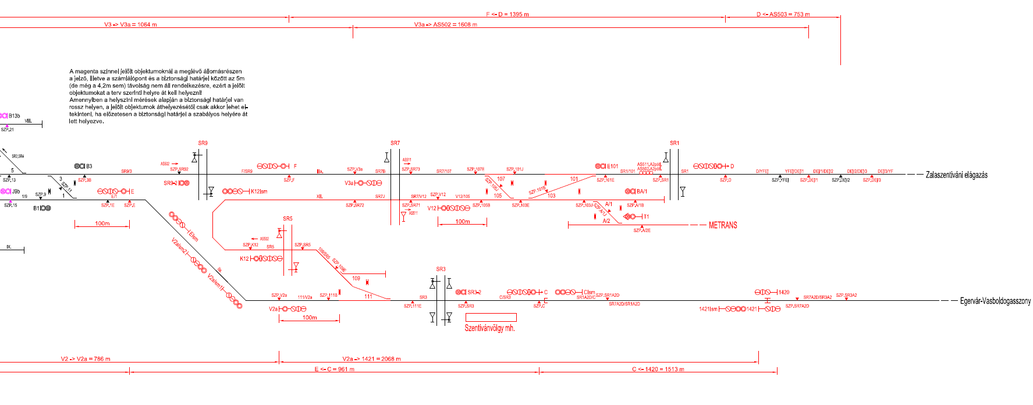
Topology of deltatrack – Approval Plan

Slide 10
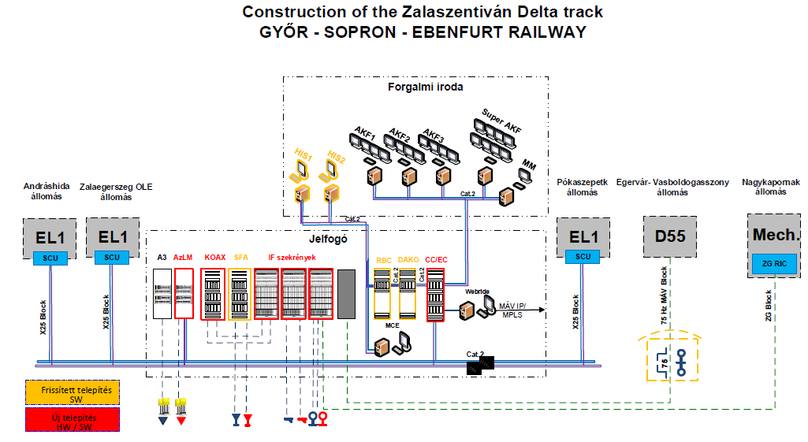
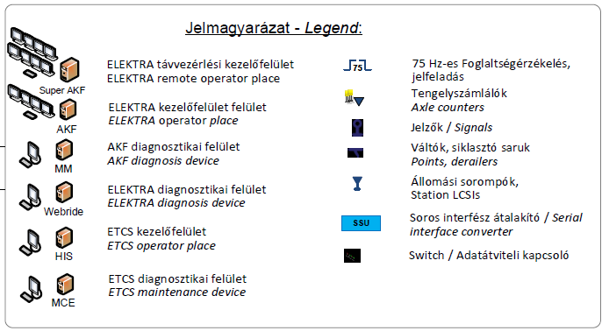
Architecture overview

Slide 11
Master Schedule Proposal
2026 |  |  |  |  |  |  |  |  |  |  | 2027 |  |  |  |  |  |  |  |  |  |  |  | 2028
2 | 3 | 4 | 5 | 6 | 7 | 8 | 9 | 10 | 11 | 12 | 1 | 2 | 3 | 4 | 5 | 6 | 7 | 8 | 9 | 10 | 11 | 12 | 1 | 2 | 3 | 4 | 5 | 6 | 7 | 8 | 9
SOR
TQR2
FQR
SRR/SFR
PDR/CDR
TRR
TQR1
AR
WS2. Design
WS2. Solution Eng.
WS2.3 Data Preparation
WS4. Lab Tests
IXL
(ELEKTRA 2)
Cust. Tests
HW ordering
HW delivery
Installation
Field Tests
PIO
WS4. Verification
Validation
Assess.
Specific SC
WP5. Solution Deployment (local)
WS2. Design
WS2. Solution Eng.
WS2.3 Data Prep I.
WS2.3 Data Prep II.
WS4. DP Verif. I.
WS4. DP Verif. II.
SW Acceptance
Lab Test I.
Lab Test II.
ETCS L2
Cust. Tests
Cust. Tests
2 months float
Install
LOCO T
PIO
WS4. Validation
PIO
WS4. Specific SC
SOR
SRR/SFR
PDR/CDR
TRR
TQR1
Assessment
FQR
TQR2

Slide 12
Solution Milestone Date Proposals
Milestone | Target Date A(Actual) P(Planned) | Solution
Solution Orientation Review (SOR) | 09/2026 P | ZIV D IL
Solution Requirement Review (SRR) | 10/2026 P | ZIV D IL
Solution Functional Review (SFR) | 10/2026 P | ZIV D IL
Preliminary Design Review (PDR) + Critical Design Review (CDR) | 12/2026 P | ZIV D IL
Test Readiness Review (TRR1) | 01/2027 P | ZIV D IL
Technical Qualification Review 1 (TQR1) and Test Readiness Review (TRR2) | 06/2027 P | ZIV D IL
Technical Qualification Review 2 (TQR2) | 07/2027 P | ZIV D IL
Final Qualification Review (FQR) | 08/2027 P | ZIV D IL
Milestone | Target Date A(Actual) P(Planned) | Solution
Solution Orientation Review (SOR) | 10/2026 P | ZIV D ETCS
Solution Requirement Review (SRR) | 12/2026 P | ZIV D ETCS
Solution Functional Review (SFR) | 12/2026 P | ZIV D ETCS
Preliminary Design Review (PDR) + Critical Design Review (CDR) | 02/2027 P | ZIV D ETCS
Test Readiness Review (TRR1) | 05/2027 P | ZIV D ETCS
Technical Qualification Review 1 (TQR1) and Test Readiness Review (TRR2) | 09/2027 P | ZIV D ETCS
Technical Qualification Review 2 (TQR2) | 10/2027 P | ZIV D ETCS
Final Qualification Review (FQR) | 12/2027 P | ZIV D ETCS

Slide 13
Finance
Contracted Values
V-S Zala Consortium
11.789.816.400 HUF
Hitachi Rail Hungary
3.450.000.400 HUF
Hitachi Rail Austria
1.150.256.458 HUF
- Advanced payment (690.000.000 HUF) has been received on 07.09.2026.

Slide 14
Risks and Opportunities
Risks:
HW order may not arrive in time for the installation activities
Budget overrun due to 2-year delay between the BID calculation and the Signed Contract.
Required times for ETCS processes cannot be fitted into the Main Contractor’s schedule.
Opportunities:
METRANS extension (Quote submitted, ~176 million HUF)
HIS workplace extension
VEZIR interface implementation

Slide 15
THANK YOU FOR YOUR ATTENTION.

